Slide 1
Neurological Disorders Lesson 5.6
What are the long-term effects of
drug abuse?

Slide 2
Do Now:
Review last night’s homework about drug use by soldiers in Vietnam with a partner.
What contributed to drug use in Vietnam?
What happened when the soldiers returned home?

Slide 3
Who is addicted?
Two people have been using morphine. Chris has been taking between 50 milligrams (mg) and 500 mg each day for a year. Pat has been taking 100 mg each day for six months.

Slide 4
Chris’s Story
Twelve months ago, Chris was in an accident and received third degree burns over 30% of his body. While in the hospital undergoing treatment, the pain was very intense. The doctors prescribed morphine that Chris could self-administer to control the pain. After all, morphine is one of the most effective pain-relief medicines available. At first, 50 mg of morphine each day would ease the pain. Later, however, Chris needed as much as 500 mg a day to ease the pain.

Slide 5
Pat’s Story
A year ago, Pat lost her job. When her savings ran out, she couldn’t afford the rent for her apartment and couldn’t afford to keep her car, so she started living on the streets. Pat became really depressed. When another homeless person offered some morphine, Pat thought the drug might help make the problems of life go away. For the past six months, Pat and friends have been shooting up morphine once each day.

Slide 6
What happened to Pat’s neurons?
Compare the structure of the two neurons below.
Why might they be different?
Control
Pat’s Neurons

Slide 7
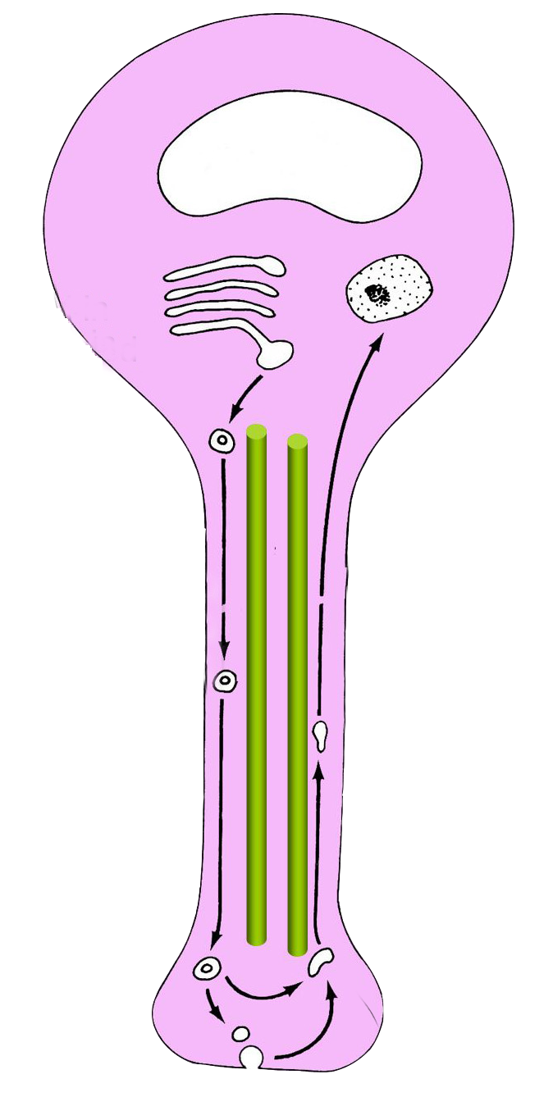
What caused these changes? What are neurons composed of?
nucleus
Neurons are made of many different proteins.
Changes in these proteins change neuron structure.
synapse

Slide 8
How are proteins changed?
What within the cell contains the code for proteins?
DNA

Slide 9
Where is DNA stored in the cell?
Nucleus
DNA
Cytoplasm

Slide 10
Where are proteins synthesized?
Nucleus
DNA
Cytoplasm
Protein
How does the DNA code in the nucleus get into the cytoplasm for proteins to be made?

Slide 11
RNA transports the code to the cytoplasm
Nucleus
DNA
RNA
Cytoplasm
Protein

Slide 12
The Central Dogma
Describes how proteins are synthesized.
DNA
RNA
Protein
Replication
Transcription
Translation

Slide 13
Neuronal stimulation causes protein synthesis
Nucleus
DNA
RNA
Cytoplasm
Drug abuse causes overstimulation of neurons.
What effect would overstimulation have on protein synthesis?
Protein

Slide 14
Overstimulation increases protein synthesis
Nucleus
DNA
RNA
Cytoplasm
Proteins assemble synapses.
What effect would increased protein synthesis have on the number of synapses?
Proteins

Slide 15
Overstimulation increases the number of synapses
Nucleus
DNA
RNA
Cytoplasm
What effect would increasing the number of synapses have on network function?
The network would function abnormally.
Proteins

Slide 16
The Brain’s Reward Circuit
Prefrontal Cortex
VTA
Normal Synapses
NAc

Slide 17
The Brain’s Reward Circuit
Drug of abuse
Prefrontal Cortex
VTA
Abnormal Synapses
NAc

Slide 18
Drug use changes neuronal structure
Normal Synapses
Abnormal Synapses
Repeated Drug Use
Once abnormal synapses have formed, would you need more or less of a drug to activate all these synapses?
You would need MORE drug to activate all the synapses

Slide 19
Tolerance
Needing more of a drug to have the same biological effect.
Or
Decreased response to a drug with repeated exposure.
Can you think of an example of tolerance in your daily life???

Slide 20
Drug use changes neuronal structure
Normal Synapses
Abnormal Synapses
Repeated Drug Use
Once abnormal synapses have formed, what would happen if you stopped using the drug?
The network would function abnormally – WITHDRAWAL SYMPTOMS.

Slide 21
Withdrawal
Wide range of symptoms that occur after stopping or reducing the amount of drug consumed after heavy or prolonged use.
Can you think of examples of withdrawal symptoms in your daily life?

Slide 22
Wrap Up:
The reward pathway is composed of the VTA, NAc and prefrontal cortex.
The DNA expression of which of these structures is altered by drugs of abuse?
The DNA of all the these structures is altered by repeated drug use.
How does this alter their physical structure?
Drug use causes an increase in the number of synapses.

Slide 23
Homework
Choose a drug of abuse and research treatment options for someone addicted to that drug.

